Slide 1

Diu Transport System
Submitted To:
Mr. Md Hefzul Hossain Papon
Lecturer
Department Of CSE
Daffodil International University
Submitted By:
Nurjahan Akther mim 221-15-4782
Abu Zahed 221-15-4716
Arnub Datta 221-15-4726
Md Amir Hamja 221-15-4784

Slide 2
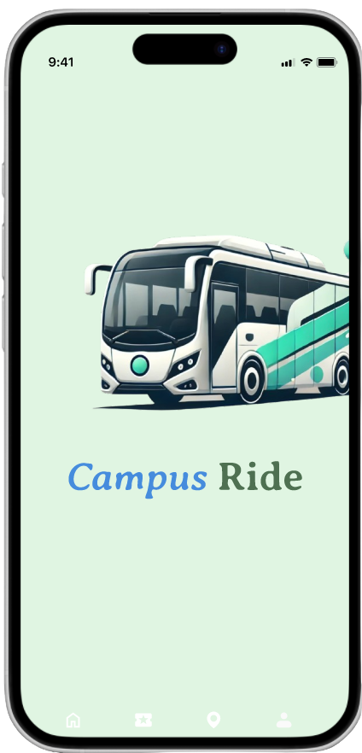

INTRODUCTION
The University Bus Transport System Application is designed to facilitate seamless transportation for students and faculty members within a university campus. With a user-friendly interface, the application allows individuals to sign up, reserve seats, track buses in real-time, and make online payments, all through a single platform. This system aims to provide an efficient, eco-friendly, and cost-effective solution for managing the university’s bus fleet.

Slide 3

Efficient bus management through scheduling,
seat reservations, and real-time tracking
Objective
Enhancing user experience for students and faculty
with a seamless platform.
Implementing real-time bus tracking using GPS
Secure online payment system for university
one-card top-ups
Scalable system design to accommodate future
growth and features

Slide 4
Motivation
Improved user experience for students and faculty.
Compliance with university transportation regulations.
1
4
Real-time bus tracking and seat reservation for better planning.
Scalable and flexible system for future growth.
2
5
Secure and transparent online payment system.
Efficient management of university bus fleet and resources.
3
6

Slide 5
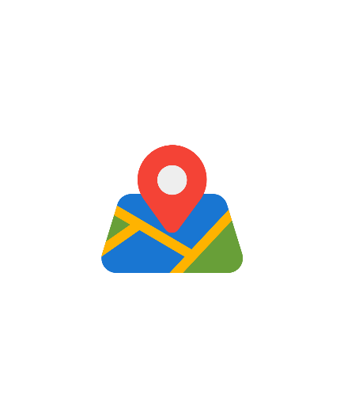
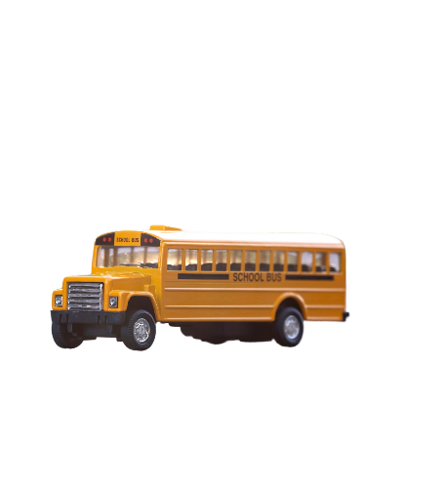

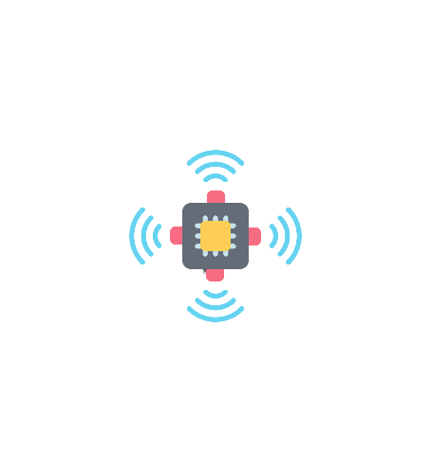
Hardware Tool
GPS Module
University Bus Fleet
Smartphones
Bus Sensors

Slide 6





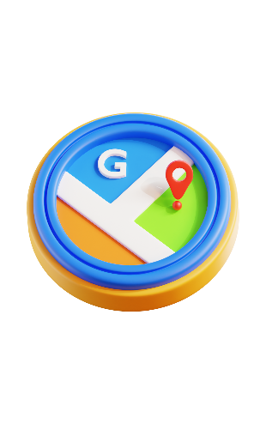

Software Tools
01
02
03
04
Flutter
Dart
Firebase
Google Maps API
For cross-platform mobile development
Programming language for Flutter
For real-time database and push notifications
For navigation and bus tracking

Slide 7
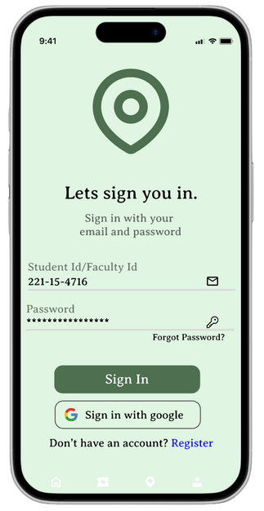
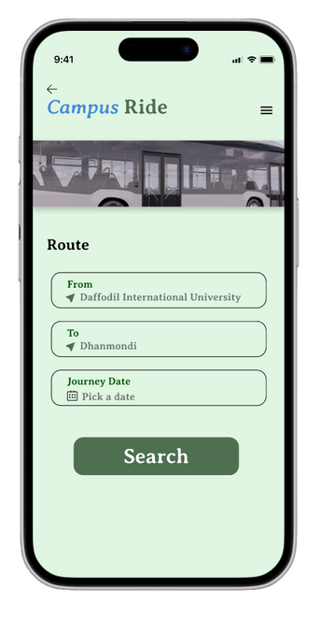
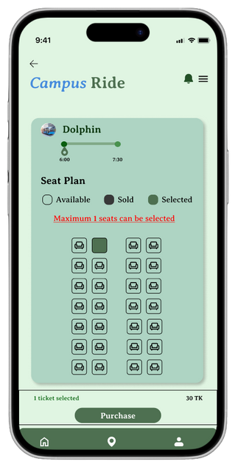
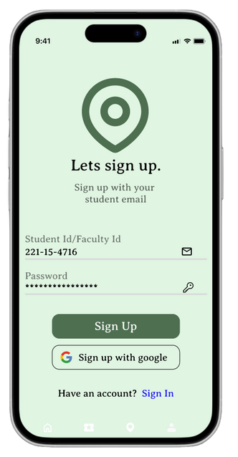
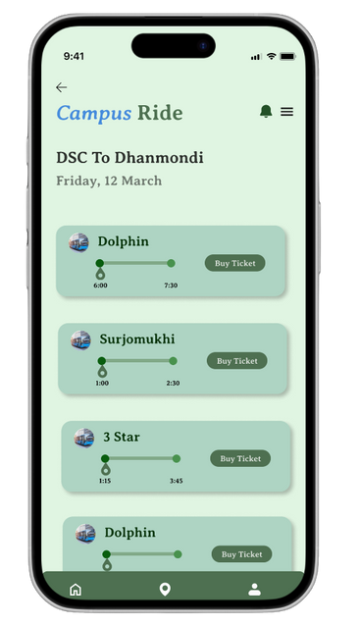
Key Feature

Slide 8
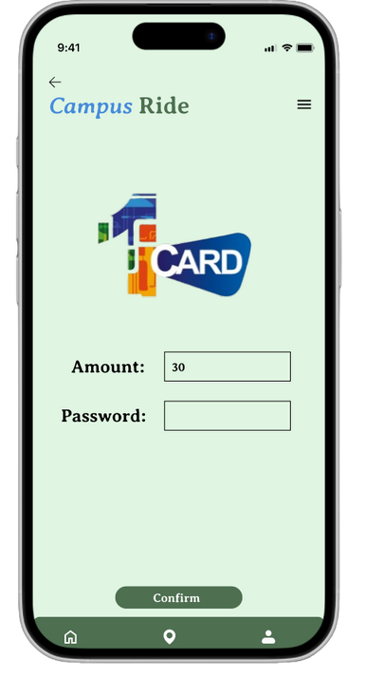
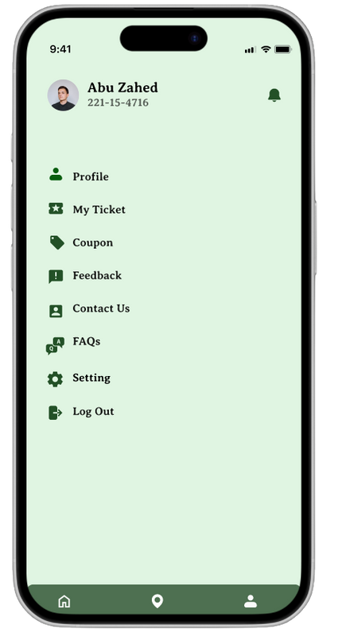
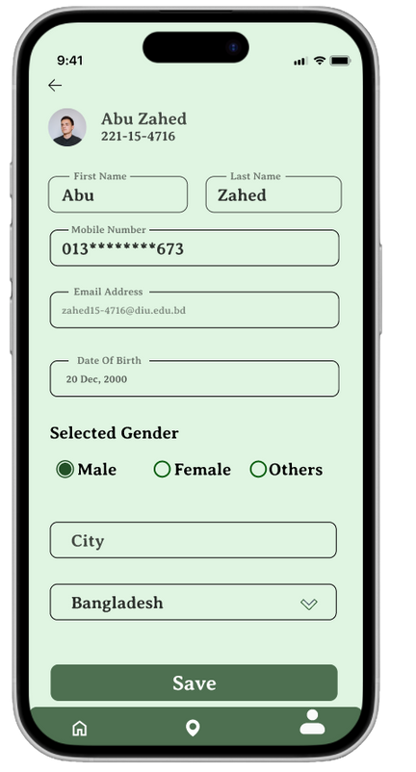
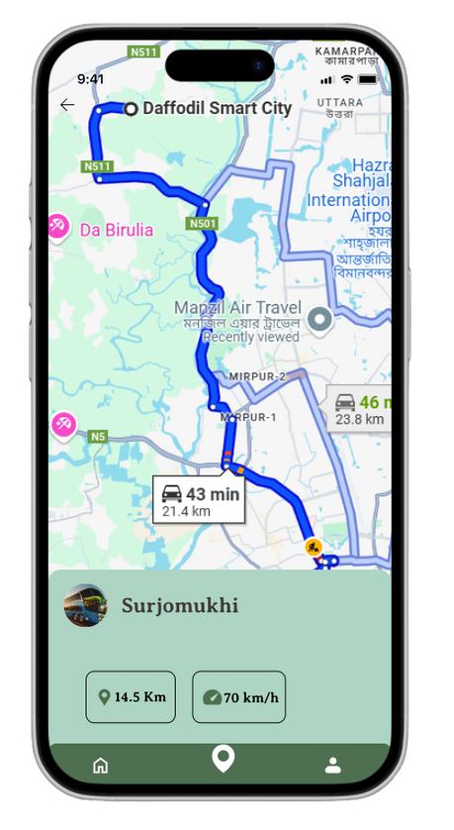
Key Feature

Slide 9
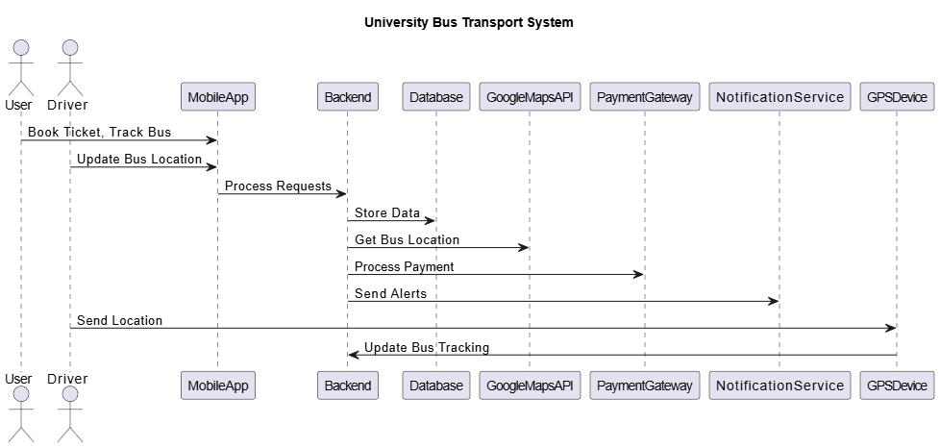

Architecture Diagram

Slide 10
Conclusion
The app makes university transportation easier and more organized.
Features include real-time bus tracking, ticket booking, and instant notifications.
The app is fast, reliable, and easy to use.
Students and staff can plan their travel better and avoid long waits.
Students can find buses quickly, book seats, and receive alerts.
Bus drivers can manage their routes better.
The app improves the convenience, safety, and reliability of university transportation.

Slide 11
THANK YOU!

